Slide 1

Tip Me! Restaurant Payment Solution on Avalanche

Slide 2



Our Team
Surya Pranesh
Shantanu Ail
4+ Years of experience as a Frontend Developer
3+ Years of experience as a Network Engineer

Slide 3
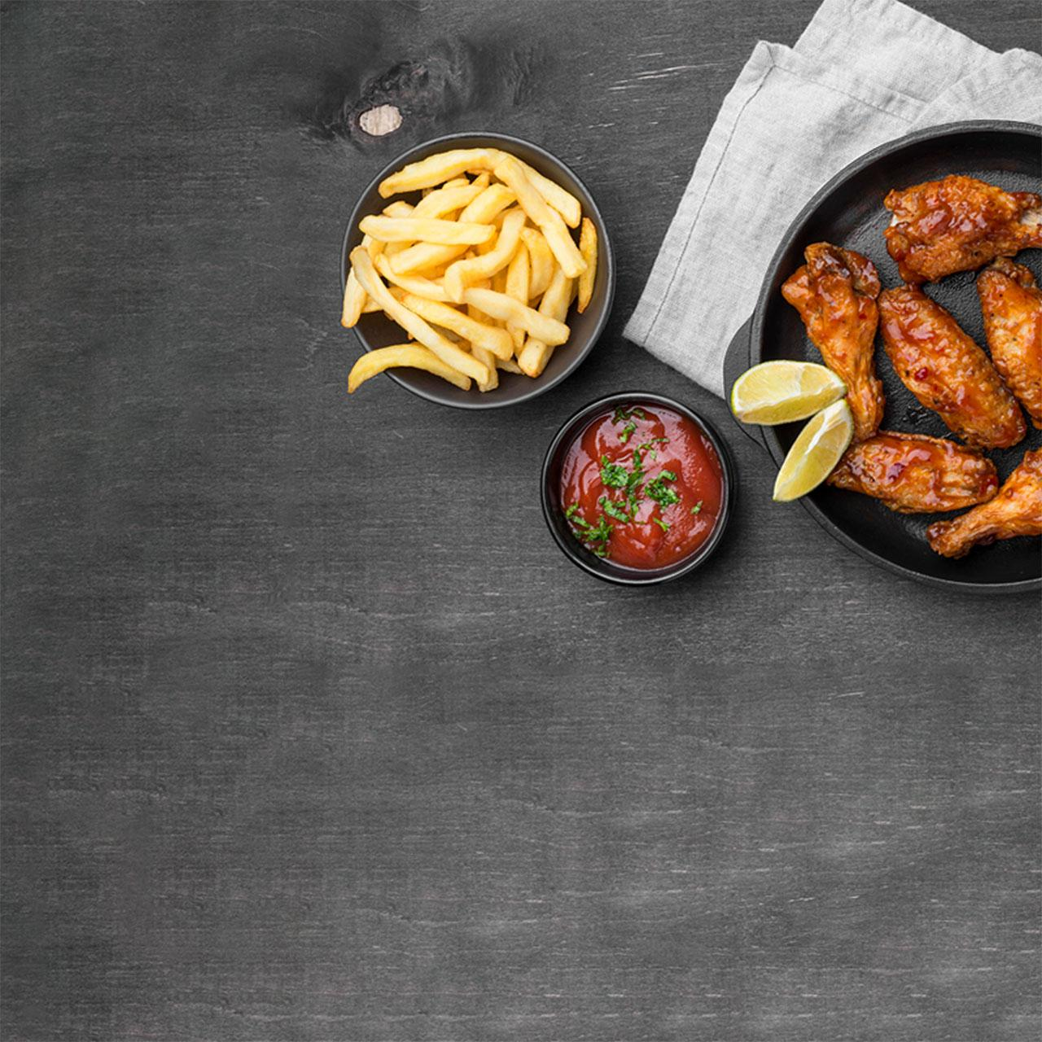
Problem Statement
Our system is here to tackle two major issues that currently plagues the restaurant business
High transaction processing fees
Unfair distribution of tips

Slide 4

Solution
Tip Me is a seamless and secure way to handle transactions in the food service industry. By utilizing Avalanche blockchain technology, this system offers speed, scalability, and low transaction fees. Say goodbye to cash and credit card payments, and hello to a new era of restaurant payments!

Slide 5

What sets us apart?
Low Transaction Fees
Fair Tip Management

Slide 6
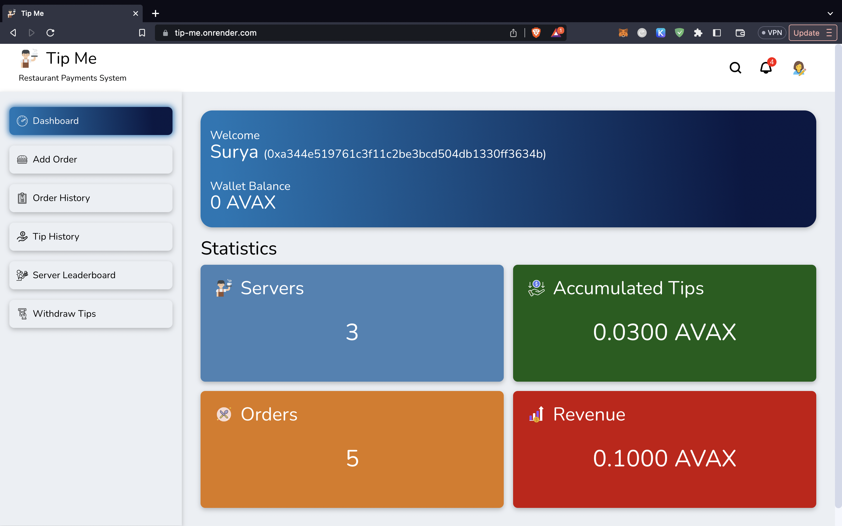
Desktop Application

Slide 7
User Journey
Customer
Server
Payment
Tips
comes to the restaurant and orders food
provides professional service to the customer
Customer makes the payment for the food along with a tip
Server collects their rightful tips at the end of the day

Slide 8

Product Demonstration

Slide 9
Future Scope
Inventory Management
Data Analysis
Mobile Application

Slide 10

Hungry to know more?
Drop us a mail for a demo for your restaurant
Suryapranesh.Krishnan@georgebrown.ca
Shantanu.Ail@georgebrown.ca

